Slide 1
Computational Thingking and Programming Introduction
Departement of Information Technology, Telkom University
Indonesia
2024
(Week -1-1)

Slide 2
Kemampuan akhir tahapan belajar
Sub-CLO-03-2-1
Mahasiswa mampu menganalisa tentang konsep berpikir komputasional
Indikator Ketercapaian Sub-CLO
Ketepatan dalam mengenali komponen utama dalam berpikir komputasional
Ketepatan dalam menjelaskan langkah-langkah untuk menyelesaikan masalah dengan berpikir komputasional

Slide 3
Tips!
CT Is Mindset not Memorize
CT must be Trained
CT must be Implemented in daily activities

Slide 4
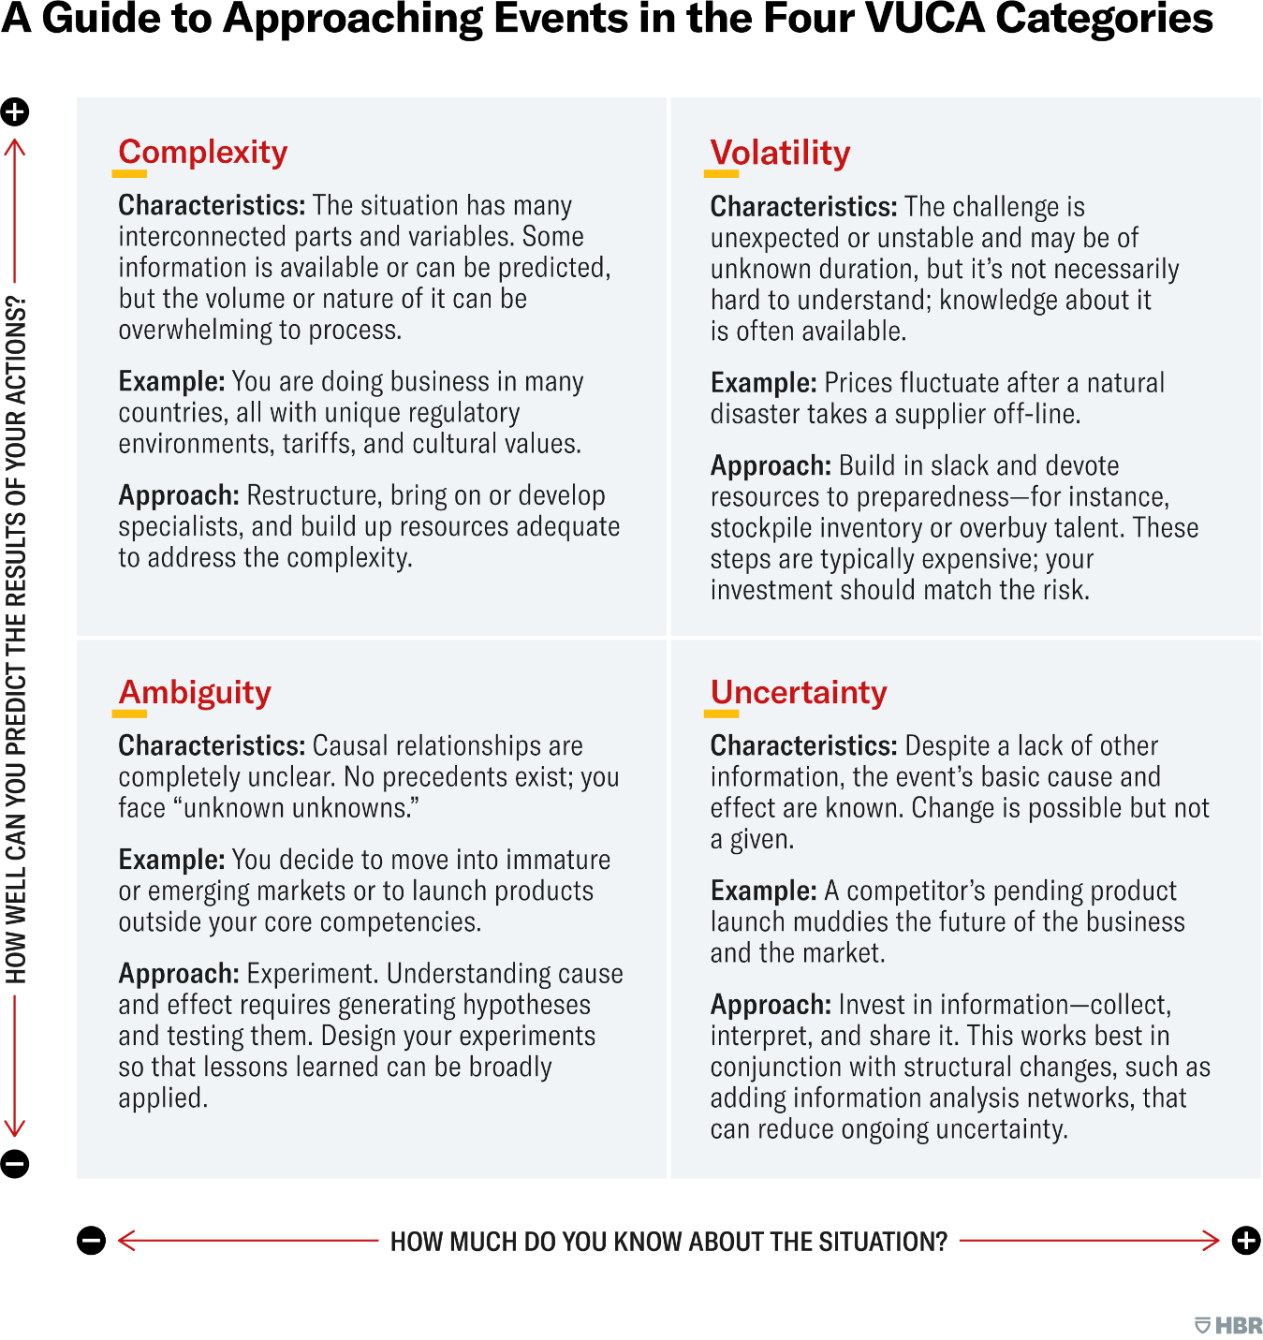
Era VUCA
Volatility
Uncertainty
Complexity
Ambiguity

Slide 5
What is Computational Thinking?
Computational Thinking is the thought processes involved in formulating problems and their solutions so that the solutions are represented in a form that can be effectively carried out by an information-processing agent
J. Cuny, L. Snyder, and J. M. Wing. Demystifying Computational Thinking for Non-Computer Scientists, 2010
Terjemahan secara bebas :
Dengan berpikir komputasional, anda dapat membuat strategi dengan cara berpikir efisien yang dapat diikuti dan dipahami oleh orang lain dan juga dapat diimplementasikan ke dalam komputer secara efektif

Slide 6
What is Computational Thinking?
Computational thinking is a way of solving problems, designing systems, and understanding human behavior that draws on concepts fundamental to computer science. To flourish in today's world, computational thinking has to be a fundamental part of the way people think and understand the world.
Computational thinking means creating and making use of different levels of abstraction, to understand and solve problems more effectively.
Computational thinking means thinking algorithmically and with the ability to apply mathematical concepts such as induction to develop more efficient, fair, and secure solutions.
Computational thinking means understanding the consequences of scale, not only for reasons of efficiency but also for economic and social reasons.

Slide 7
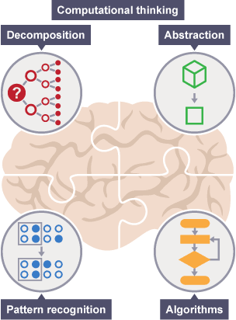
The Key Components of Computational Thinking
Decomposition: This involves breaking down intricate problems into smaller, more understandable parts. By dividing a problem into manageable components, individuals can approach it more systematically and address each element independently.
Pattern Recognition: Computational thinking emphasizes the ability to recognize recurring structures or trends within data or information. Identifying patterns enables individuals to make informed decisions and predictions based on existing evidence.
Abstraction: Abstraction involves simplifying complex systems by focusing on essential details while disregarding irrelevant information. This simplification makes it easier to conceptualize and work with complex concepts or systems.
Algorithmic Thinking: Algorithmic thinking entails designing step-by-step procedures or algorithms to solve problems. It encourages individuals to think logically and consider the sequence of actions required to reach a solution.
Notes:
https://innovativeteachingideas.com/blog/five-reasons-why-computational-thinking-is-an-essential-tool-for-teachers-and-students/

Slide 8
Where is Computational Thinking Used?
Computer Science and Programming: Computational thinking is foundational to computer science and programming. It underpins the creation of software, algorithms, and coding practices.
Science and Research: Researchers use computational thinking to analyze and model complex scientific phenomena, from climate patterns to genetic sequences.
Mathematics: It aids in solving mathematical problems, including optimization and data analysis.
Engineering: Engineers apply computational thinking to design systems, analyze structural integrity, and optimize processes.
Business and Data Analysis: In the business world, computational thinking is employed for data analysis, market research, and process optimization.
Healthcare: It plays a role in medical research, disease modelling, and healthcare process improvement.
Education: Computational thinking is integrated into educational curricula to enhance problem-solving skills across subjects.
Everyday Life: Individuals use computational thinking when planning daily routines, solving puzzles, making decisions, and troubleshooting problems, even if they are unaware of it.

Slide 9
Why Computational Thinking?
I Know how to go faster from summarecon distric to Telkom university sukapura. (Bandung)
I can make some program to implement this way and make everyone to do the same with me
My work can be used by others

Slide 10
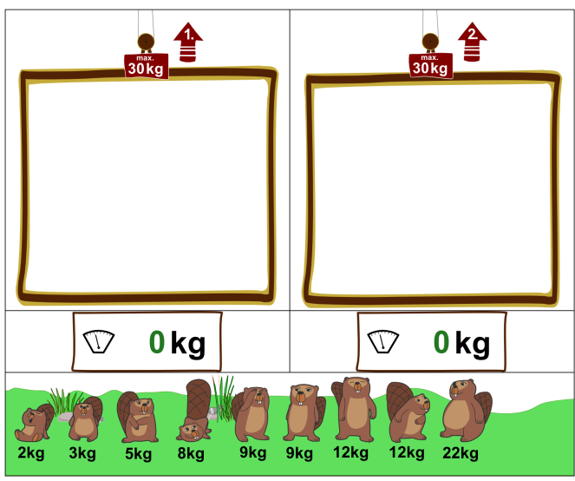
Latihan menemukan solusi dari soal CT
Ada sekumpulan berang-berang yang mempunyai berat beragam ingin menaiki lift dengan beban maksimal masing-masing 30 Kg. Bagaimana cara mengatur berang-berang tersebut agar dapat memuat sebanyak mungkin dari mereka naik secara bersamaan?
Contoh Jawaban :
Lift 1 : 2kg, 3kg, 5kg, 8kg, dan 12kg
Lift 2 : 12kg, 9kg, 9kg

Slide 11
Mindset berpikir komputasional Anda dilatih dengan masalah(problem) dengan menggunakan cara berpikir (thinking)
Gunakan mindset berpikir
Be a Problem Solver !
Soal CT Bukan
sembarang soal

Slide 12
Pikirkanlah tentang cara anda berpikir
Abstraksi :
Berang-berang -> objek, lift -> kelompok
Kelompokkan sejumlah objek dengan bobot berbeda menjadi dua grup
Sebanyak mungkin objek dikelompokkan -> Tujuan
Maksimal 30kg per kelompok -> ada batasan/ kendala/ Constraint
Pengenalan Pola :
Ini masalah optimasi!, apakah anda pernah menemukan solusi dari masalah yang sama dimasa yang lampau?
Misalkan: kalian pergi Refreshing offroad di hutan pinus dengan teman dan ada tiga mobil yang bisa digunakan. Bagaimana agar semua orang bisa pergi dengan tiga mobil tadi?
Masukkan dulu orang yang bertubuh paling kecil!
Dekomposisi :
Apakah ada kaitan antara kelompok 1 dan kelompok 2 ? → Tidak
Setiap Objek hanya bisa masuk ke satu kelompok
Sehingga masalah ini bisa di –dekomposisi menjadi dua persoalan : Kelompok 1 dan kelompok 2
Maksimalkan kelompok 1, lalu maksimalkan kelompok 2 dengan sisa objek yang belum dipakai.
Rancangan Strategi (Algoritma)
Urutkan menaik berdasarkan bobot
Berang-berang yang paling ringan bobotnya naik lebih dahulu
Solusi:
Lift 1 : 2 3 5 8 9 = 27 kg
Lift 2 : 9 12 = 21 kg
→ Solusi belum optimal? → Perbaiki algoritma kalian.

Slide 13
Apa yang anda pelajari dari problem ini?
Contoh problem optimasi : mencari solusi “terbaik” diantara beberapa alternative solusi
Elemen persoalan optimasi: Objektif dan kendala → cari menggunakan abstraksi dan dekomposisi
Strategi (Algoritma) dapat kalian gunakan. Misal: berang-berang paling ringan prioritas yang naik lift dahulu sehingga makin banyak berang-berang yang dapat masuk lift. Konsep ini bernama greedy
Evaluasi: cek strategi kalian, apakah jawaban kalian optimal?, jika tidak perbaiki jawaban kalian. →darimana kalian bisa tahun jawaban dihasilkan adalah solusi optimal?
Ada banyak soal-soal lain dan strategi berpikir lain yang akan diperkenalkan lewat latihan soal-soal. → mengenali pola dari soal.

Slide 14
Cari Contoh problem yang sejenis !

